Slide 1
Different Techniques to Improve MapReduce Performance with SSDs
Team hulk

Slide 2
Outline
HDFS Application Background
How HDFS works for reading and write?
SSD Improvement Techniques
Technique1: Pre-load SSD Cache
The benchmark: DFSIO, TeraSort
Technique2: SSD as Storage Device
Technique3: Optimize FTL algorithm for SSD

Slide 3
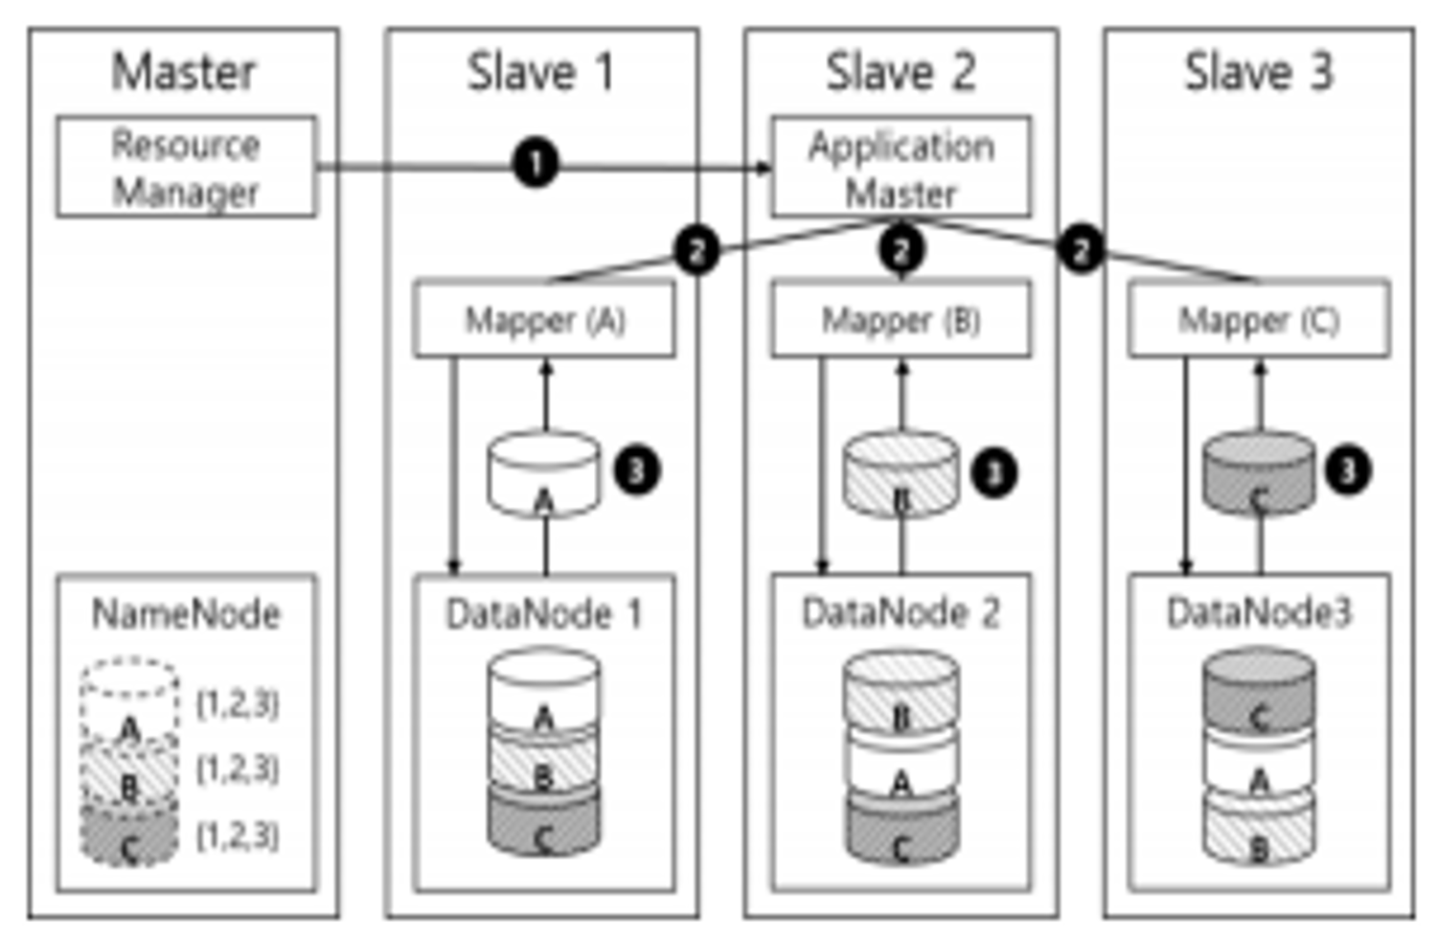
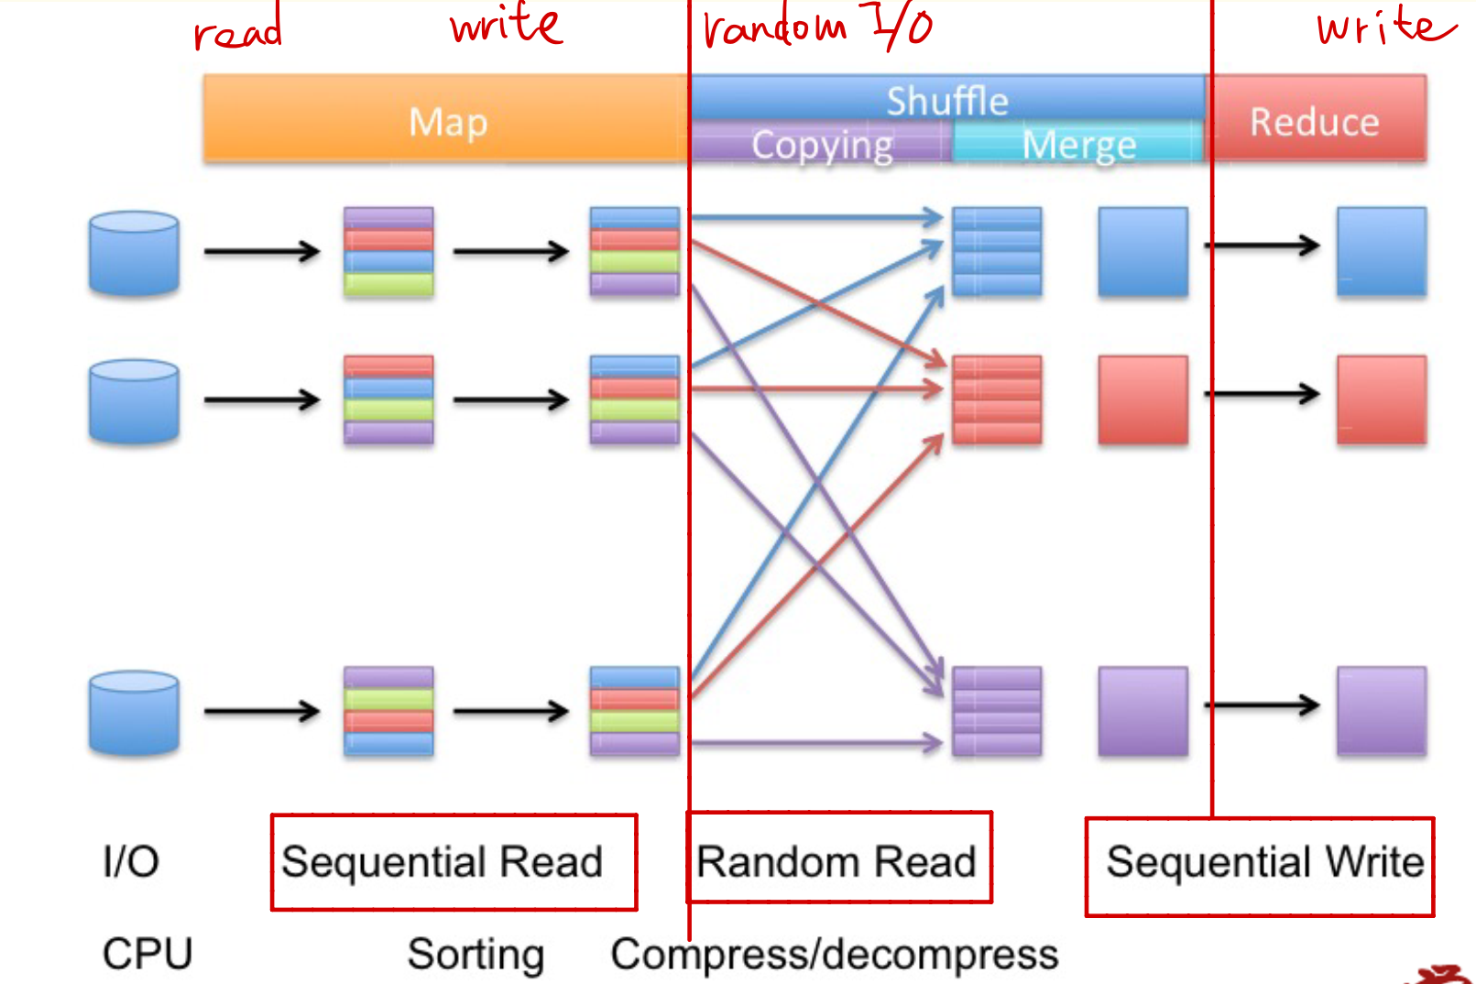
HDFS & MapReduce Workflow
Apply Technique1
Apply Technique2

Slide 4
Exemplary Benchmark
Hadoop’s exemplary benchmarks, Terasort and TestDFSIO.
TestDFSIO is a program to measure I/O speed of HDFS that is built-in in Hadoop.
TeraSort is the program that measures the entire performance of MapReduce that was built in Hadoop including the computing power of the node where the program was being carried out, which was different form TestDFSIO

Slide 5
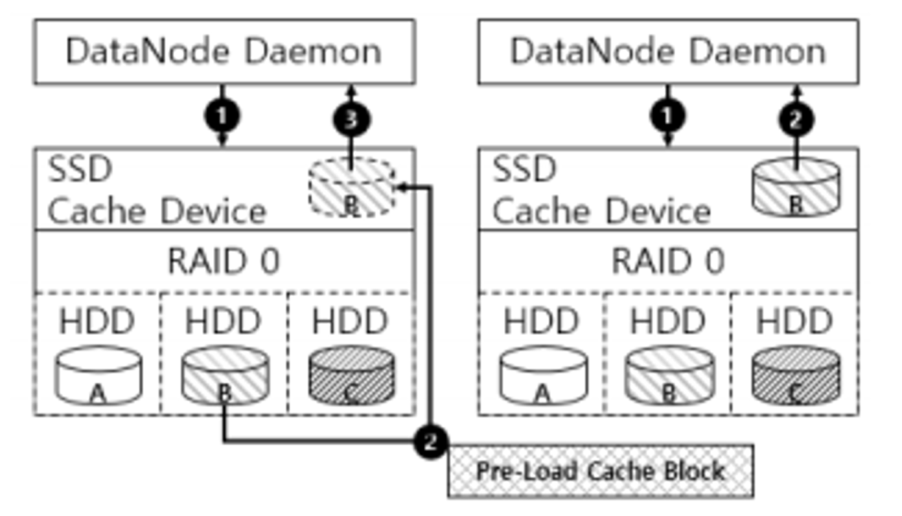
Technique1: Pre-Load SSD Cache Idea
We can simply use SSD cache as an improvement method.
However, Hadoop is implemented in JAVA , it causes bottlenecks via JVM
we use the HDD as a pre-loading cache block into SSD cache device. This can mainly increases the cache hit ratio by get the block information of spited files to be used and loading it before I/O request in associated block.

Slide 6
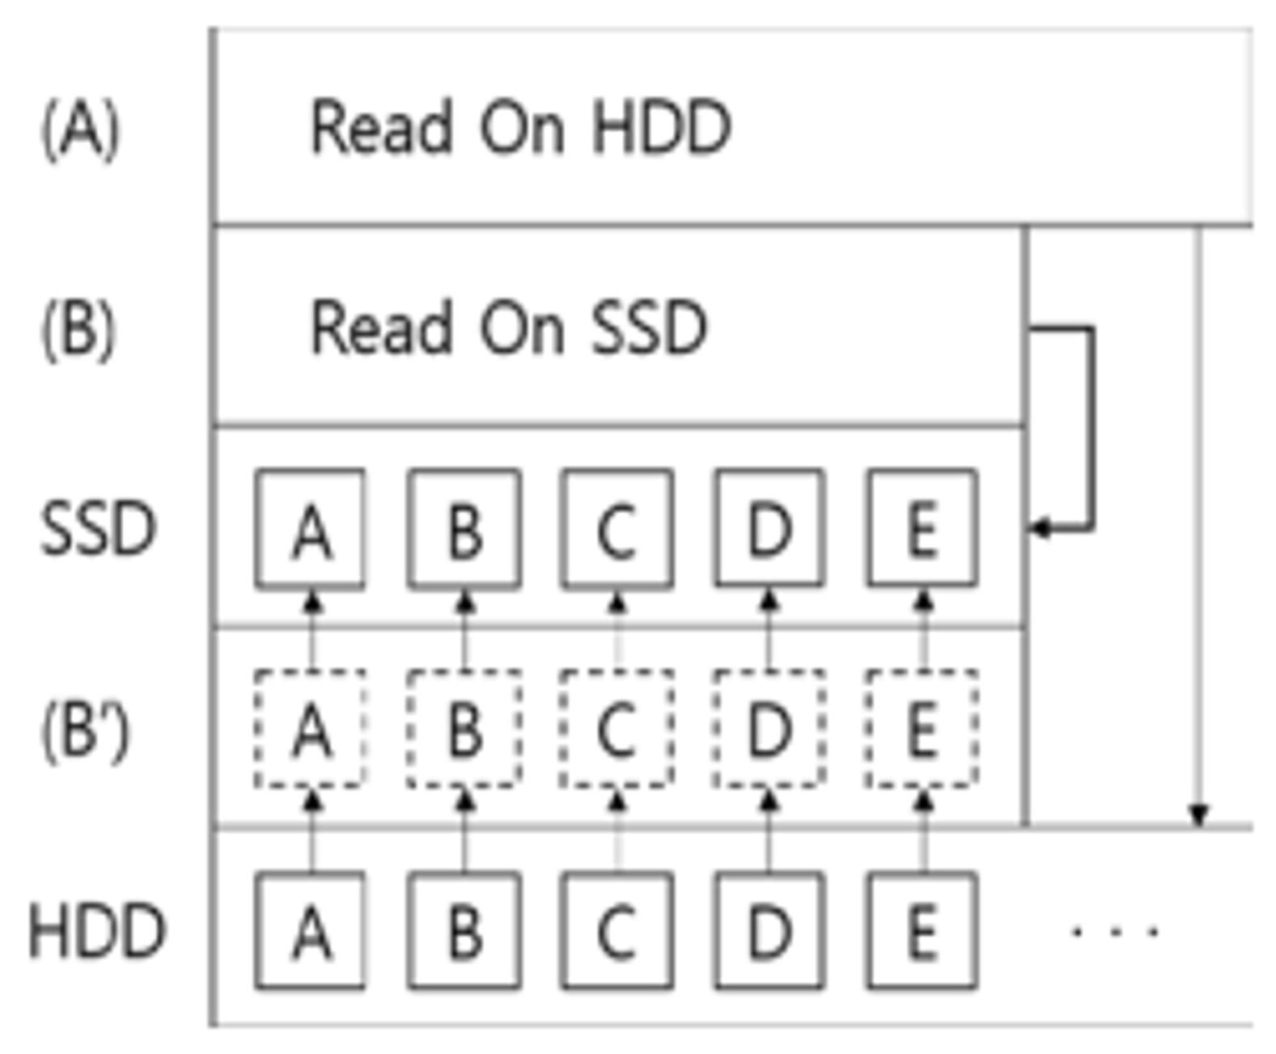
Technique1: Pre-Load SSD Cache DESIGN
But here we can use SSD cache and the pre-load process, loading the data in advance using metadata (block ID)
Generally the process is like (A) to HDD directly

Slide 7
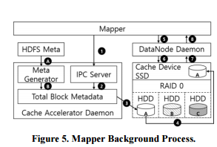
Technique1: Pre-Load SSD Cache DESIGN
cache daemon program:
(A):outputs HDFS metadata via Hadoop fsck command.
(B):constructs a Total Block Metadata in CAD (Cache Accelerator Daemon) and stores block information in HDFS.
(1)the information about the split file is received from the mapper
(2) searches the associated block in Total Block Metadata and based on the found block information
(3) requests to load the blocks to SSD cache via CLI command.
(4) Cache device loads the requested block to SSD
(5) the mapper requests a split file block to a data node.
(6) The data node requests a split file block to SSD cache
(7) bring the pre-loaded block Ａ
(8) delivers it to the mapper

Slide 8
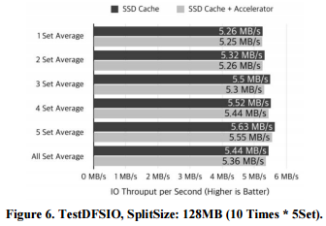
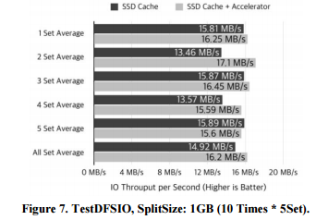
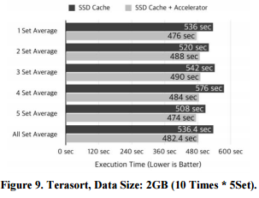
RESULT Technique1: Pre-Load SSD Cache

Slide 9
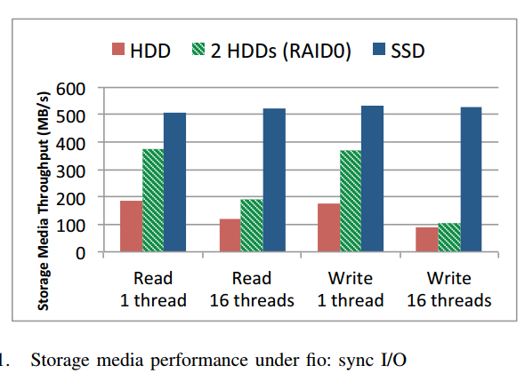
Technique2: Intermediate SSD shuffle inspiration
Can we use SSD to substitute HDD as the data storage?
What will be the problem if we do so?

Slide 10
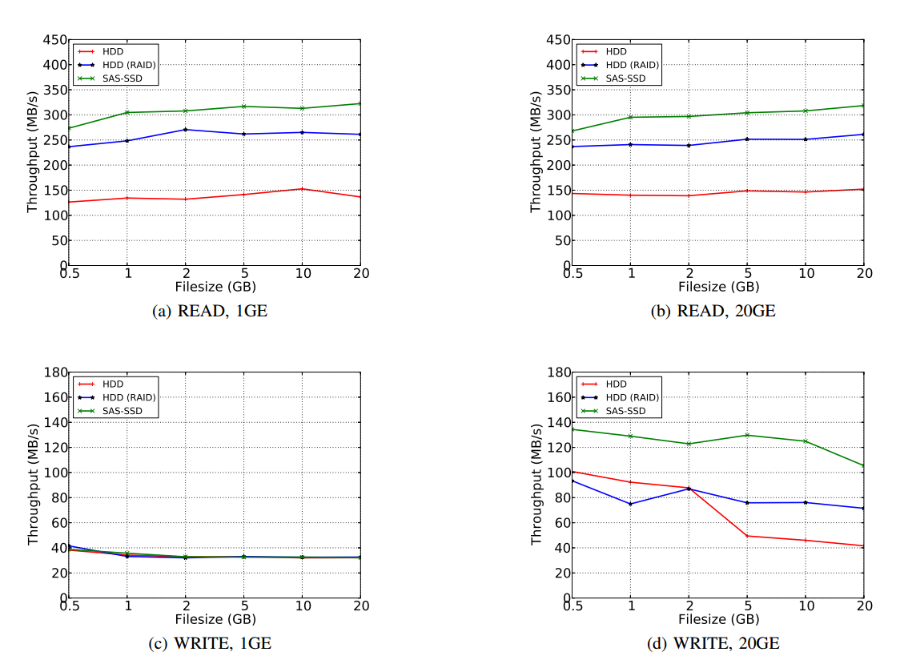
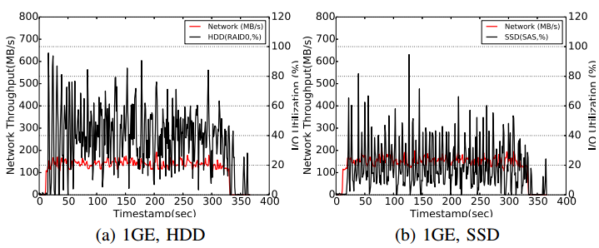
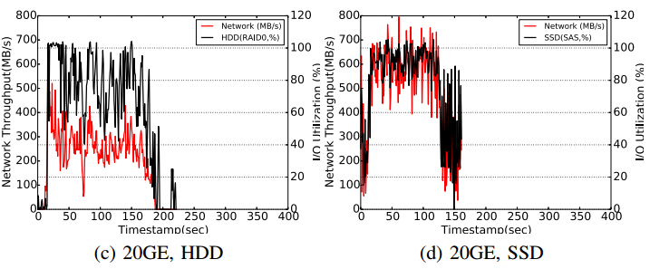
Technique2: SSD as storage device DFSIO-analysis
The network influences the performance of MapReduce
Jobs greatly.
What else?
DFSIO Throughput Based on File size, Network Link Bandwidth, and Storage Device
DFSIO-Write Resource Utilization (Network Throughput and I/O Utilization)

Slide 11
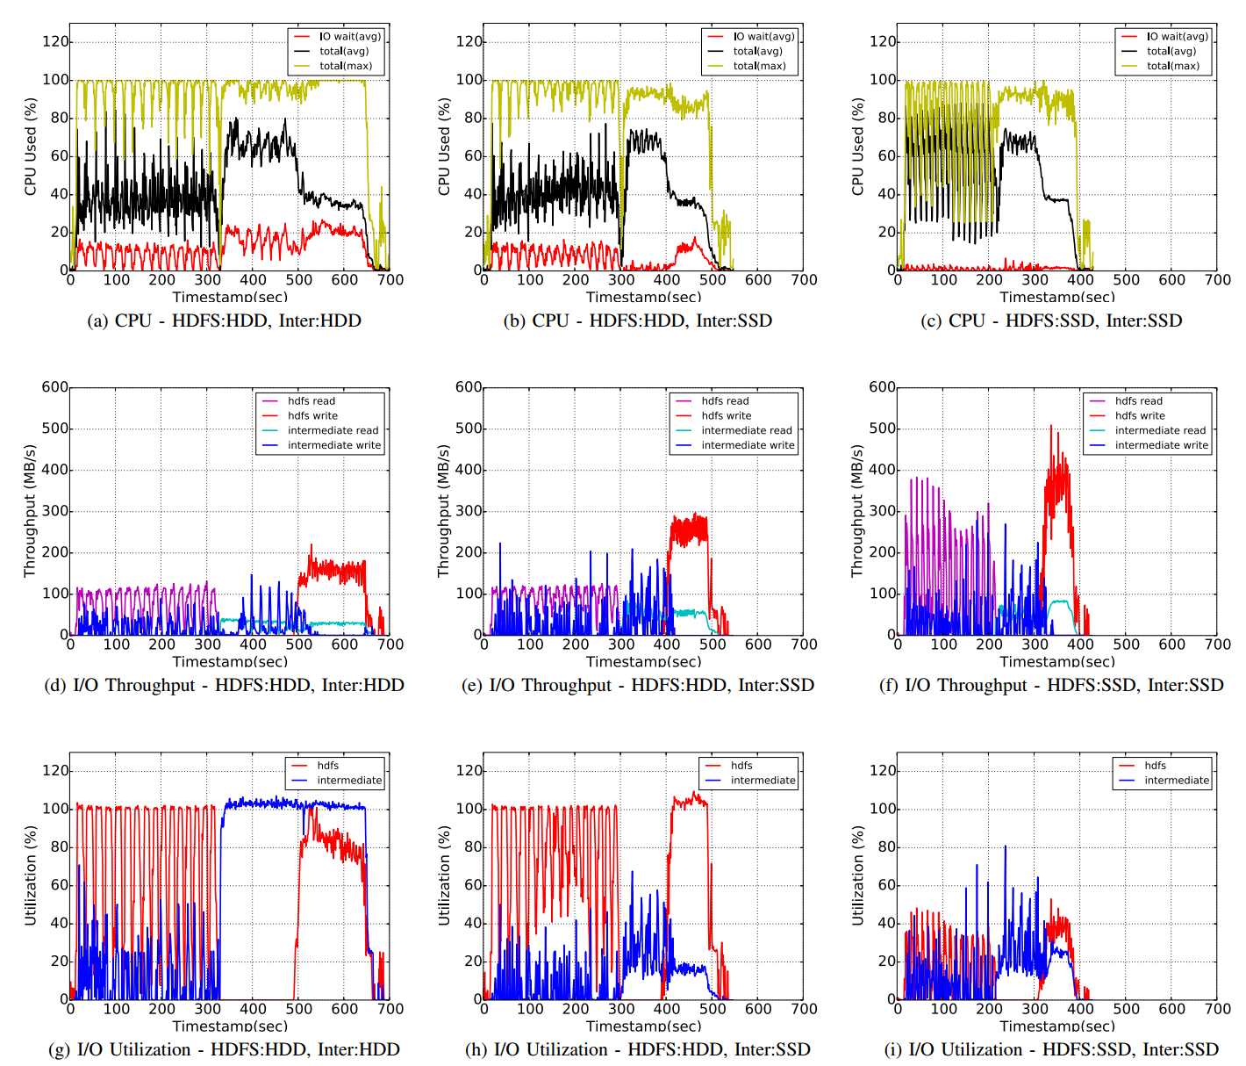
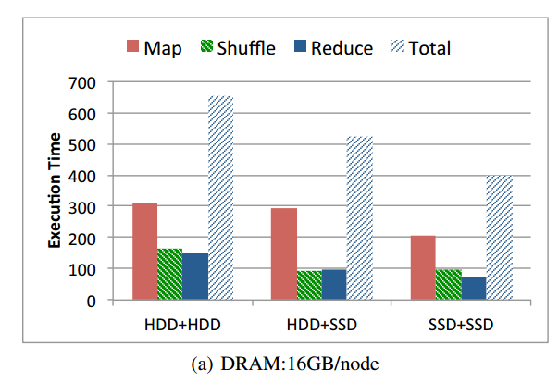
Technique2: SSD as storage device terasort-analysis
CPU Used
I/O Throughput
HDFS vs Inter
Execution Time
I/O Utilization
HDFS vs Inter
So should we use SSD in the whole system?

Slide 12
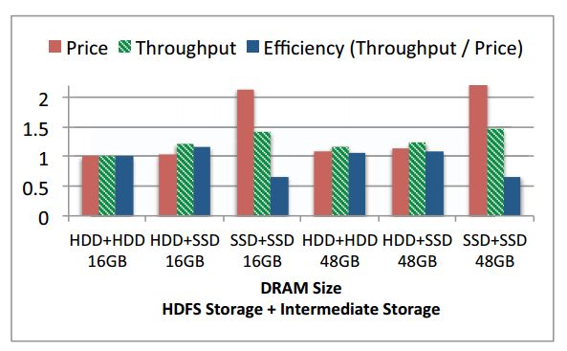
Technique2: SSD as storage device Overall
Sufficient Network Bandwidth
&
Intermediate
Shuffle
Actually, using HDD for HDFS and SSD for Intermediate is better

Slide 13
Technique3: Optimized FTL Algorithm Overall
“However, we expect that the new NAND technology such as
3D-NAND will make SSDs more cost-effective and replace
HDD in next few years - even in big data storage applications.”
read
page
FTL translate logical to physical access pattern
Operation on FTL:
Address mapping table
Garbage collection
Error Correction Code
……
page
Performance
Life time
page
Reliability
write
block

Slide 14
Technique3: Optimized FTL Algorithm Choices
Better for random access
But not good for sequential
Page Level Mapping
FAST – Fully Associative Sector Translation
BAST – Block Associative Sector Translation
GC Merge
Problem
Block Level Mapping
Divide into data blocks and log blocks. Use BL for data blocks, use PL for log blocks. One data block to one log block.
LAST –
Locality-Aware Sector Translation

Slide 15
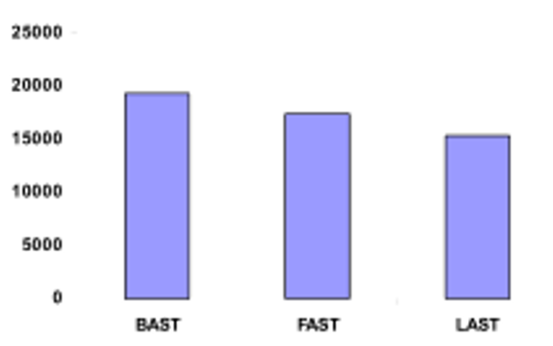
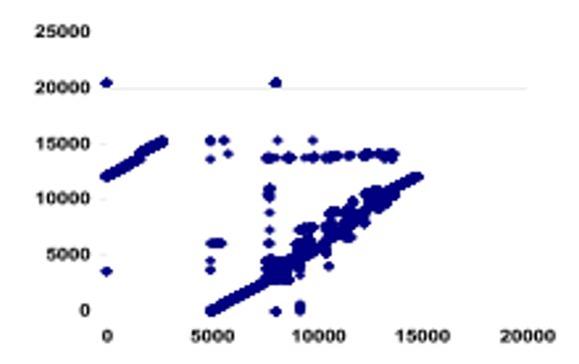
Technique3: Optimized FTL Algorithm outcome
Erase
Count
L2P
Access
Pattern
WHY:
Because the merge steps can be reduced and the storage is used at an optimized way

Slide 16
Summary & Conclusion
What we have studied and surveyed:
1. HDFS Read & Write patterns.
2. SSD Cache improvements.
3. HDFS performance using SSD under different configurations.
4. SSD FTL algorithm.
Conclusions:
For different cases, the way using SSD to improve MapReduce performance verifies. If we want to make full use of the SSD, we need to have sufficient network bandwidth (also enough computation resources). And using SSD as the intermediate data storage is more efficient. Otherwise, we might just apply some cache as a supplement in other parts of the system.
FTL algorithm should be evaluated for sustainability.

Slide 17
Potential Further Study
For Technique1:
* What’s the cost of using the SSD cache if no cache is used in the original system.
* The cost of implementing cache daemon program.
For Technique2:
* How to get the optimized plan for using SSD as storage giving different environments?
For Technique3:
* Because this is mainly about choosing the SSD model, so what is the actual difference between different algorithms?

Slide 18
Reference
S. Moon, J. Lee , Y. S. Kee, “Introducing SSDs to the Hadoop MapReduce Framework” in 2014 IEEE International Conference on Cloud Computing
J. H. An, Y. Kim, K. Jeon, “Design and Implement of Pre-Loading SSD Cache Data Using Split File on Hadoop MapReduce” in RACS Proceedings of the 2015 Conference on research in adaptive and convergent systems, Pages 457-460
H. Jeon, K. E. Maghraoui, G. B. Kandiraju, “Investigating Hybrid SSD FTL Schemes for Hadoop Workloads” in CF ’13 Proceedings of the ACM International Conference on Computing Frontiers, Article No.20

